Slide 1
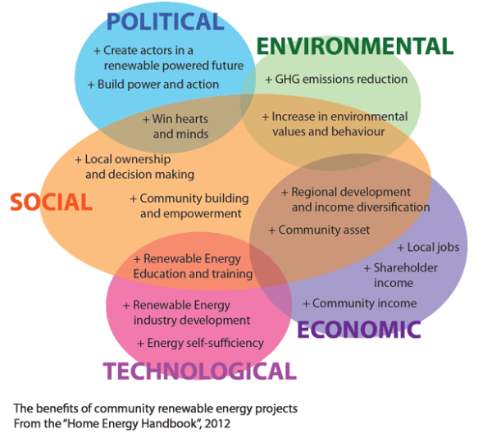
Totally renewable
Environment
Environment, yourself, community
No coal
Whole community understanding inevitable change
Building understanding
Showcase
Change is exciting
Rapid transition
Fairness – cost in/cost out
Develop learning e.g. For remote aboriginal communities
Community voices
POLITICAL
ENVIRONMENTAL
Massive benefits with good choices
Help people who can’t have solar
Community power hub
Contribute to community level of self-sufficiency
Things that are happening locally
Internet tele-health
Emergencies/ Blackouts
Community ownership
Sense an opportunity for the community
Invest in community projects
End of grid
Affordability after retirement
Better use of exports
Economic benefits
Help individuals access renewable energy
Part time community members happy to support
Serve the whole of the community
Like the idea of community initiatives
Support good ideas
Ind > Comm or Comm > ind
Resilience
3 day blackout – big scare especially for health and carers
Bushfires
Fire fighting
Transport
Water pumps needs power
More batteries
Back up – extra support
Wind share and store
Off grid town
ECONOMIC
SOCIAL
TECHNOLOGICAL

Slide 2
POLITICAL
ENVIRONMENTAL
ECONOMIC
SOCIAL
TECHNOLOGICAL
Notes:
template

Slide 3
Instructions
Hold an event – In Venus Bay we had a community energy forum with two speakers.
Ask people why they’ve come and what interests them about energy
Or hold an energy vision workshop, which is what we did in Heyfield – this exercise was at the end of a weekend talking about microgrids and mapping energy assets.
Sort the results – this template helps you with different ways to think about people’s answers.
Use this information to remind people what your community ambition is.
The results in slide one is from Venus Bay. The smaller inset diagram was written by Jarra Hicks and Nicky Ison.

